Slide 1
MFY Legal Services and the Coalition of Institutionalized Aged & Disabled:
25 Years of Advocating for Adult Home Residents

Slide 2
Judge Postpones Closing of Group Home
By Somini Sengupta, July 1, 2000
Lawyers with MFY Legal Services, a nonprofit group that represents the residents, said they were relieved by the judge's order but also worried about whether their clients would receive the best kinds of placements in all the rush.
''Given the lack of supported housing for people with mental illness, we are concerned whether appropriate placements'' can be made within three weeks, said Jeanette Zelhof, managing attorney with MFY Legal Services. ''The hasty placements may result in residents leaving the placements because they are not appropriate for them. That's how you contribute to the cycle of the homeless mentally ill.''

Slide 3
Inquiry Finds Mentally Ill Patients Endured 'Assembly Line' Surgery
By Clifford J. Levy and Sarah Kershaw, March 18, 2001
Still, lawyers at MFY Legal Services, Disability Advocates and Patterson, Belknap, Webb & Tyler, which brought the suit on behalf of the men, said the state had not done enough. They are asking a federal judge to remove the home's operator, Jacob Rubin, and are seeking damages from the two doctors, Jamile A. Peress and Harry Josifidis.

Slide 4
A FINAL DESTINATION: For Mentally Ill, Death and Misery
By Clifford J. Levy (Part 1 of 3), April 28, 2002
Many of private them.
Many of the private homes for the mentally ill in New York have devolved into places of misery and neglect, just like the psychiatric institutions before them.

Slide 5
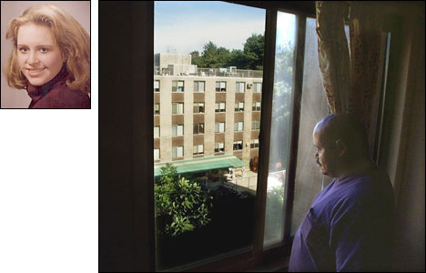
WHERE HOPE DIES: Here, Life Is Squalor and Chaos
By Clifford J. Levy (Part 2 of 3), April 29, 2002
The Seaport Manor in Canarsie, Brooklyn, has long been one of the most troubled adult homes for the mentally ill in New York.

Slide 6
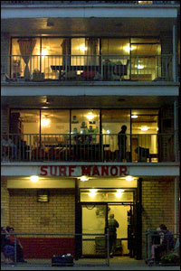
THE OPERATORS: Voiceless, Defenseless And a Source of Cash
By Clifford J. Levy
(Part 3 of 3), April 30, 2002
Ever since New York began replacing its psychiatric wards with adult homes, the residences have become magnets for schemes that exploit the mentally ill.

Slide 7
The Opinion Pages: New York's Mentally Ill
To the Editor:
Re ''State Will Create Office to Investigate Homes for the Mentally Ill'' (news article, June 12):
Judge Ira B. Harkavy's order appointing a receiver to operate Seaport Manor Home for Adults in Brooklyn until it is closed is not the end of the matter. Once the home is closed, the very operators who have for years permitted conditions to exist at the home that threatened the life, health and safety of the residents appear to be poised to re-open a shelter, again financed by public money.
The Health Department should make sure this does not happen. It should negotiate a deal in which the building will continue to be leased to a supported housing provider. And the new office to investigate homes should ensure that meaningful civil or criminal penalties, or both, be imposed upon these operators.
Jeanette Zelhof
New York, June 12, 2002

Slide 8
Queens Home For Mentally Ill Settles Lawsuit For $7 Million
By Clifford J. Levy, August 5, 2004
''This lawsuit, which became a catalyst for adult home reform, is important because it illustrates how individuals without a voice and little power can assert their rights and obtain positive changes in their lives in the face of daunting obstacles,'' said Jeanette Zelhof, managing lawyer for MFY Legal Services, a nonprofit legal group.

Slide 9
Residents Bring 'Homes' to Albany to Protest
By Etanjalie Narraph, January 31, 2005
After driving from New York City during a snowstorm, a group of adult home residents carried four boxes representing their homes into the mental health and hygiene budget hearing last week in protest. The adult home residents all have mental health problems and attended the hearing with members from the Coalition of Institutionalized Aged and Disabled to protest the lack of housing options available to them and the need for independent case management.

Slide 10
Group Home Where Man Died in Fire Was Closed to New Arrivals
By Marc Santora and Leslie Kaufman, May 10, 2005
"There has been a long history of halfhearted and failed attempts by the state to bring enforcement proceedings against Brooklyn Manor," said Jeanette Zelhof, Deputy Director of MFY Legal Services, Inc., an advocacy group for the mentally ill. "It's time to empower residents to bring a proceeding on their own behalf."

Slide 11
THEY'RE STEAMED: MENTALLY ILL TENANTS DEMAND AIR CONDITIONING
By Cassi Feldman, August 5, 2005
“Since these are state licensed facilities, we strongly believe that it's the state's responsibility to ensure that air conditioning is available to residents free of charge,” said Tanya Kessler, adult home project director at the Coalition of the Institutionalized Aged and Disabled. “The only way that'll happen is if the state funds it.” Kessler estimates that providing air conditioning to the 30,000 residents of adult homes statewide would cost an estimated $7 million.

Slide 12
They Have Beds, but Not the Ones They Want
By Jennifer Bleyer, December 30, 2007
Over the summer, Mr. Bloomfield and other members of an advocacy group called the Coalition of Institutionalized Aged and Disabled took steps to dramatize their plight and pressure government to take action. They set up a list of people who are waiting for independent accommodations. A few weeks ago, the number of names on the list passed the 200 mark. ….
According to Geoff Lieberman, the coalition’s executive director, the goal is to prompt the state’s Office of Mental Health to help create more supportive housing specifically for adult-home residents. Sixty units of supportive housing are now in the pipeline — 20 each for Brooklyn, Queens and the Bronx — but, he said, “many more people want to move than 60.”

Slide 13
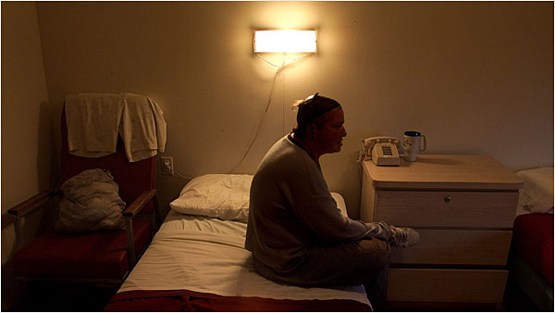
State Discriminated Against Mentally Ill, Judge Rules By James Barron, September 8, 2009

Slide 14
State Discriminated Against Mentally Ill, Judge Rules (continued)
A judge said the use of adult homes violated federal law.
Jeanette Zelhof, the deputy director of MFY Legal Services, one of a number of groups that helped with the legal work in the case, said the decision meant that adult-home residents “will no longer be stigmatized by living in adult homes.”
“In their communities,” Ms. Zelhof said, “these homes were seen as psychiatric institutions, and they were run like psychiatric institutions.”

Slide 15
Judge: Mentally Ill Should Move Homes to Neighborhoods
By Lauren Cox and ABC NEWS Medical Unit, March 4, 2010
Residents of Adult Homes speak out in a rally organized by the Coalition of Institutionalized Aged and Disabled (CIAD). CIAD is a non-profit, grassroots organization run by and for adult home and nursing home residents and resident councils.

Slide 16
Don't go soft on Medicaid fraud
By Jeanette Zelhof and Jota Borgmann, September 23, 2011
Reining in Medicaid costs is a top priority in New York. Legislators are pushing for the state to assume county Medicaid costs, which are growing faster than counties can raise property taxes ("State-run Medicaid on table," Sept. 20). It is, therefore, confounding that legislators take the opposite view when it comes to enforcement.

Slide 17
Residents sue Coney Island adult home for bedbug infestation and shoddy conditions
By Mark Morales, May 8, 2012
Norman Bloomfield, 64, is one of the plaintiffs suing Surf Manor Home for Adults in Coney Island for terrible living conditions. Photographed in front of the home. (Pearl Gabel for New York Daily News)

Slide 18
Hundreds of elderly and disabled New Yorkers evacuated during Hurricane Sandy are still homeless By The AP, December 26, 2012
Geoff Lieberman, executive director of the Coalition of Institutionalized Aged and Disabled, an advocacy group, said finding facilities to accept displaced people in a disaster is a challenge.
"There is no one adult home that has anywhere near the capacity that you really need to safely and comfortably accept 100 or 200 other residents," he said.
The Bishop Henry B. Hucles Episcopal Rehabilitation and Skilled Nursing Center in Brooklyn is one of several New York city facilities that took in hundreds of elderly and disabled New Yorkers evacuated from seaside nursing homes and assisted living residences after Superstorm Sandy. (AP Photo/Kathy Willens)

Slide 19
Residents told to repay aid funds given to them two years ago
By David B. Caruso and Michael Kunzelman,
November 9, 2014
Lawyers at MFY Legal Services, a legal aid group that has worked with adult-home residents, have offered to help the Belle Harbor Manor residents with their appeals.

Slide 20
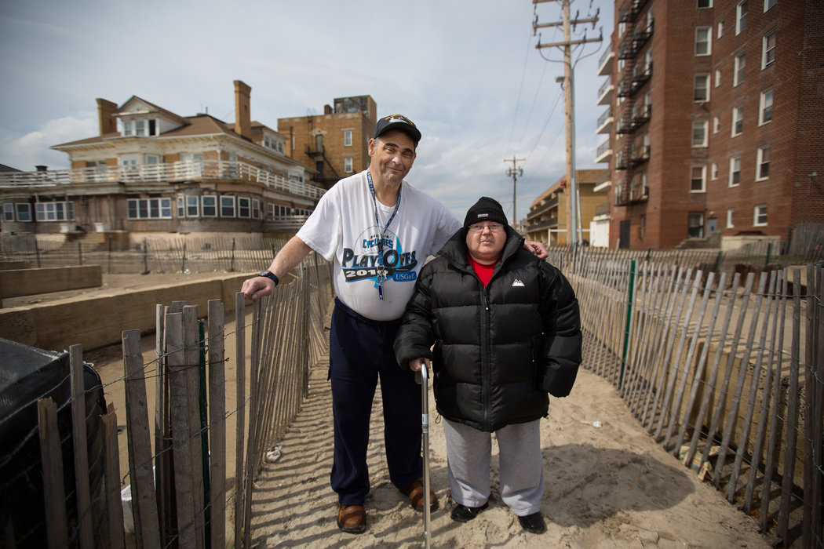
Medicaid Shift Fuels Rush for Profitable Clients
By Nina Bernstein, May 8, 2014
Mr. Ramdaou complained last fall to Jota Borgmann, a lawyer with MFY Legal Services who has protested such marketing for two years, fruitlessly calling for an audit of potential fraud, and reporting specific complaints directly to Mark Kissinger, the state’s chief of long-term care, at Mr. Kissinger’s request.

Slide 21
At Assisted-Living Home Set to Close, Holdouts Dig In as Services Dry Up
By Vivian Yee, Nov. 28, 2014
Alice Singer, 90, is among those who have sued to remain in the Prospect Park Residence, which is to become condominiums.
Credit Hiroko Masuike/The New York Times

Slide 22
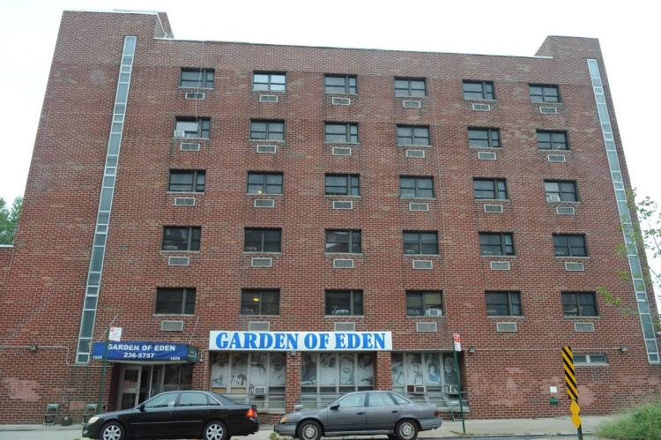
Adult group homes in NYC accused of sending residents to psychiatric emergency rooms as punishment for ‘misbehavior’ by Barbara Ross, December 24, 2015
MFY Legal Services, a nonprofit group that litigates on behalf of the poor, wants the courts to order the city to turn over tapes of 911 calls from those homes.

Slide 23
In a Lonely Corner of Coney Island, a Fight Over Care for the Vulnerable, by Joaquin Sapien, May 24, 2017
Dionne Ward and David Vargas, residents at the Oceanview Manor Home for Adults in Coney Island, sit on a bench along the boardwalk. (Hilary Swift for ProPublica)

Slide 24
In a Lonely Corner of Coney Island, a Fight Over Care for the Vulnerable (continued)
But advocates charge that the assisted living program is not much more than a financial boon for the adult home industry with few tangible benefits for residents.
“It presents an opportunity for the homes to make even greater profits,” said Jota Borgmann, a senior attorney for MFY Legal Services, which represents residents in a variety of litigation involving adult homes. She said the program affords maximum discretion to home administrators in determining a resident’s level of need. Under current rules, administrators can charge Medicaid as much as $128.69 extra per resident, per day.

